Slide 1

WINE QUALITY PREDICTION
PRESENTED BY:- RAJ KUMAR
BATCH-81

Slide 2
PROBLEM
The dataset contains the information about White and Red wines.
Management wants the characteristics of these wines .
How different ingredients affect the quality.
We have to build a model to classify wines in Good and Bad category.

Slide 3
DATA DESCRIPTION
Type - Type of wine red/White.
volatile acidity - Volatile acidity is the gaseous acids present in wine.
fixed acidity - Primary fixed acids found in wine are tartaric, succinic, citric, and malic.
residual sugar - Amount of sugar left after fermentation.
citric acid - It is weak organic acid, found in citrus fruits naturally.
Chlorides - Amount of salt present in wine.
free sulfur dioxide - So2 is used for prevention of wine by oxidation and microbial spoilage.
total sulfur dioxide - Total sulphur dioxide.
pH- In wine pH is used for checking acidity.
density
Sulphate- Added sulfites preserve freshness and protect wine from oxidation, and bacteria.
Alcohol- Percent of alcohol present in wine.
Quality - Rating by customers.

Slide 4
QUALITY DEFINITION
We will define a wine is Good or Bad based on Rating by tester.
If quality rating is more than 5 it is Good else Bad.
Based on this categorisation We have 4113 Good wines and 2384 Bad wines.
Now we divided wine in two category based on rating, there is no more use of quality rating.

Slide 5
DATA DESCRIPTION
Dataset contains 6497 Rows and 13 Columns.
Dataset contains 1 int type column.
Dataset contains 11 float type columns.
Dataset contain 1 object type column.

Slide 6
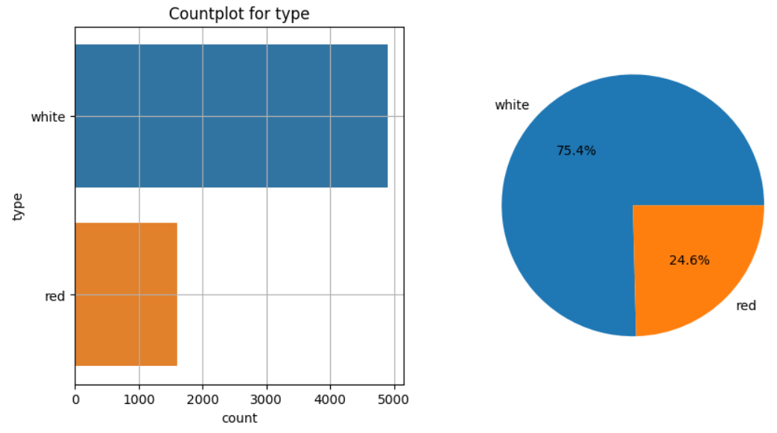
EDA
Dataset contains 75.4% samples of White wine and 24.6% samples of Red wines.

Slide 7
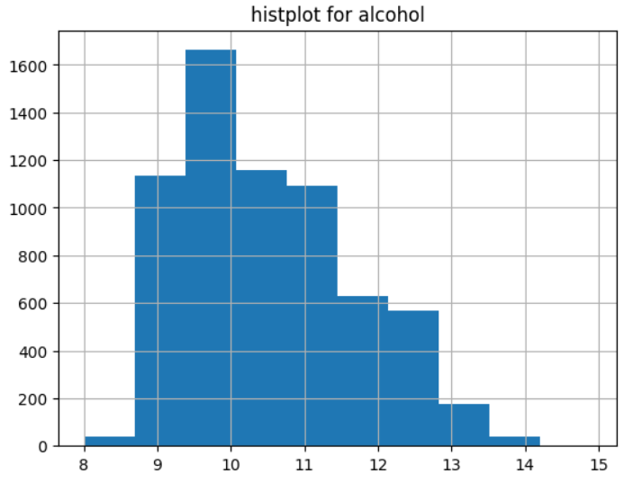
EDA
Maximum wines contain 9-13% Alcohol.

Slide 8
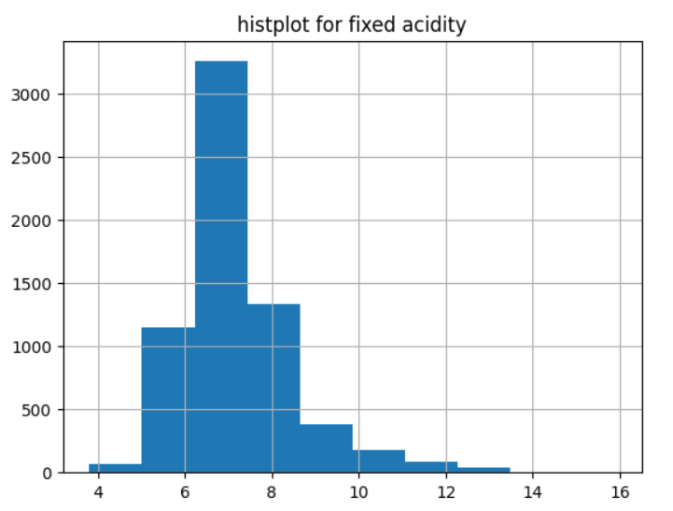
EDA
Maximum wines contain 6-8% Fixed acidity.

Slide 9
TRAINING AND TESTING DATA
We will use 20% data for testing and 80% data for training.
Quality_dist is dependent feature and rest all are Independent features.
Model will predict for Quality_dist by using all other dimensions.
CODE
#importing train test split from model_selection
from sklearn.model_selection import train_test_split
x=data.drop(["quality_dist"],axis=1) #input features except quality_dist
y=data["quality_dist"] #output feature "quality_dist"
x_train,x_test,y_train,y_test=train_test_split(x,y,test_size=0.2) #spliting data into train(80%) and test(20%)

Slide 10
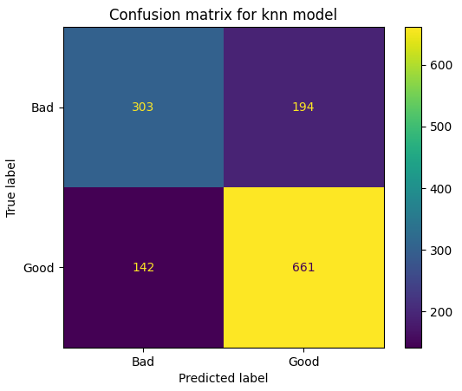
KNN CLASSIFIER MODEL
Observations based on KNN model :-
Accuracy score for train data is : 0.8379834519915336
Accuracy score for test data is : 0.7415384615384616
Train accuracy is much more than Test Accuracy.

Slide 11
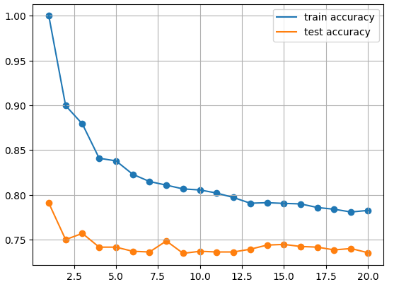
KNN CLASSIFIER MODEL
Accuracy score analysis with different value of K.
From the graph it can be seen that with the high value of k model trying to fit best.

Slide 12
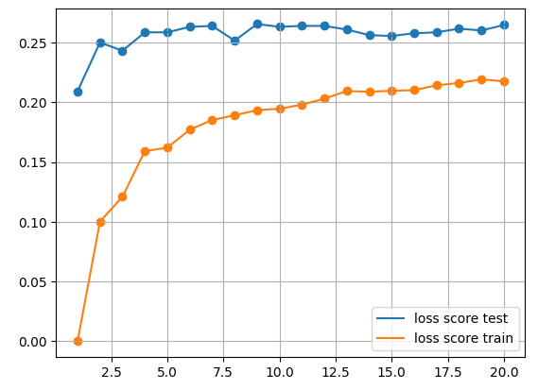
KNN CLASSIFIER MODEL
Loss score analysis with different value of K.

Slide 13
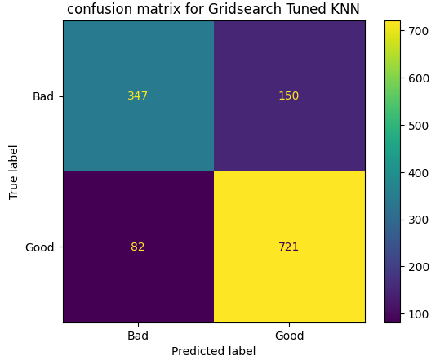
KNN CLASSIFIER MODEL
Model evaluation after perform hyperparameter tuning.
Accuracy score for tuned knn is : 0.8215384615384616
Accuracy score improved from 74% to 82% By tuning.
False positive and False negative also decreases.

Slide 14
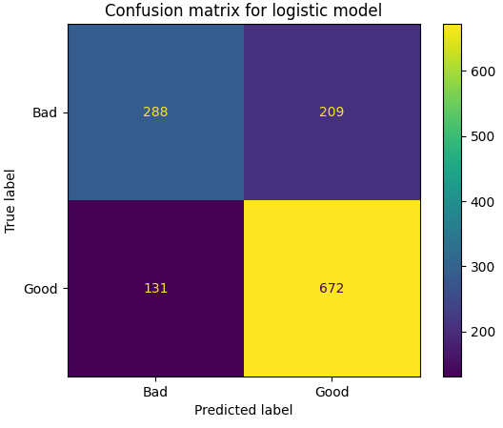
LOGISTIC REGRESSION MODEL
Observations based on Logistic regression model :-
Accuracy score for training data is : 0.7465845680200115
Accuracy score for test data is : 0.7384615384615385
Train accuracy and Test accuracy are almost same.

Slide 15
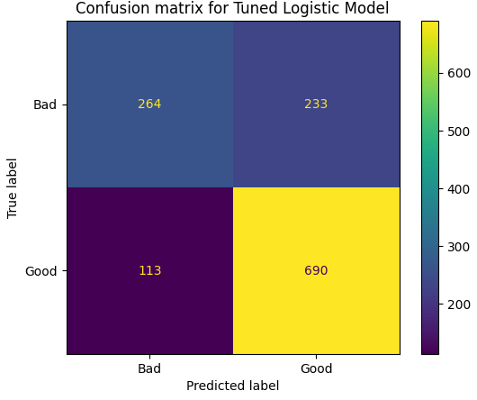
LOGISTIC REGRESSION MODEL
Observations based on Tuned Logistic regression model :-
Accuracy score for Tuned Logistic model is :0.7338461538461538
Slight improvement in Logistic model.

Slide 16

SUPPORT VECTOR CLASSIFIER MODEL
Observations based on SVC model :-
Accuracy score for train data is : 0.8035405041370021
Accuracy score for test data is : 0.7684615384615384

Slide 17

SUPPORT VECTOR CLASSIFIER MODEL
Observations based on SVC tuned model :-
Accuracy score for Tuned SVC model is : 0.7707692307692308
Slight improvement by tuning in model.

Slide 18
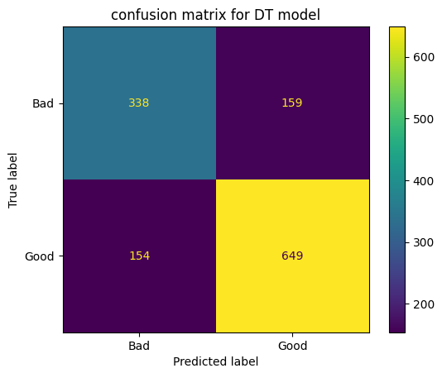
DECISION TREE CLASSIFIER MODEL
Observations based on DT classifier model :-
Accuracy score for train data is : 1.0
Accuracy score for test data is : 0.7592307692307693

Slide 19
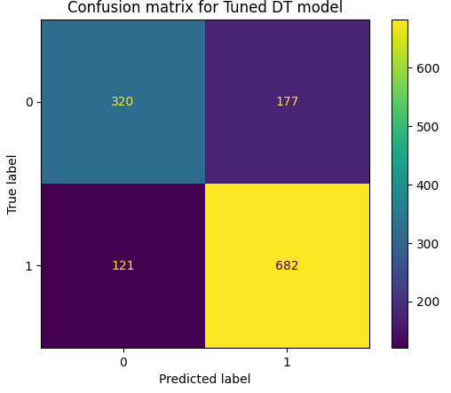
DECISION TREE CLASSIFIER MODEL
Observations based on DT Tuned classifier model :-
Accuracy score for Tuned DT classifier model is : 0.7707692307692308

Slide 20

RANDOM FOREST CLASSIFIER MODEL
Observations based on RandomForest classifier model :-
Accuracy score for train data is : 0.999615
Accuracy score for test data is : 0.815323

Slide 21
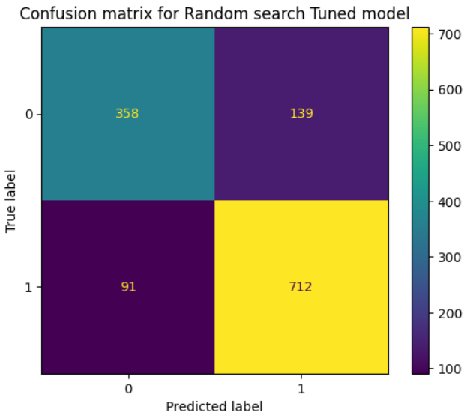
RANDOM FOREST CLASSIFIER MODEL
Observations based on Random forest Tuned classifier model :-
Accuracy score for Tuned Random Forest classifier model is : 0.82307692

Slide 22
EVALUATION OF MODELS
We have predictions for all the models.
Based on accuracy score we can see that KNN model is more accurate to predictions after tuning.
Random forest model is also good with both categories But after tuning it is performing good for only one category.
Slight improvement in Confusion matrix and Accuracy score is observed in models.

Slide 23
THANK YOU

